Slide 1
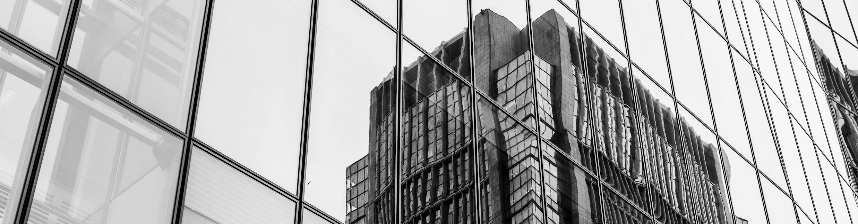
ChequeVision App
Aadil Arsh S R - 21z201, Preetha Selvarasu - 21z237, S Karun Vikhash - 21z247, Sanjay Kumaar Eswaran - 21z248, Subhasri Shreya - 21z260

Slide 2
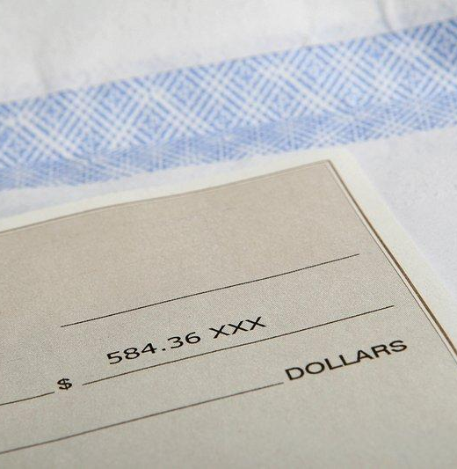
Problem Statement
Imagine a bank that processes a lot of cheques every day. Currently, this process involves a lot of manual work, like checking signatures and technical details. This manual work takes a long time and requires a lot of people.

Slide 3

Objective
1. Reading Cheque Information (OCR)
2. Verifying Signatures
3. Checking Technical Details
4. Handling Different Languages
5. Automating the Process
6. Detecting Fraud
7. Testing and Improvement

Slide 4
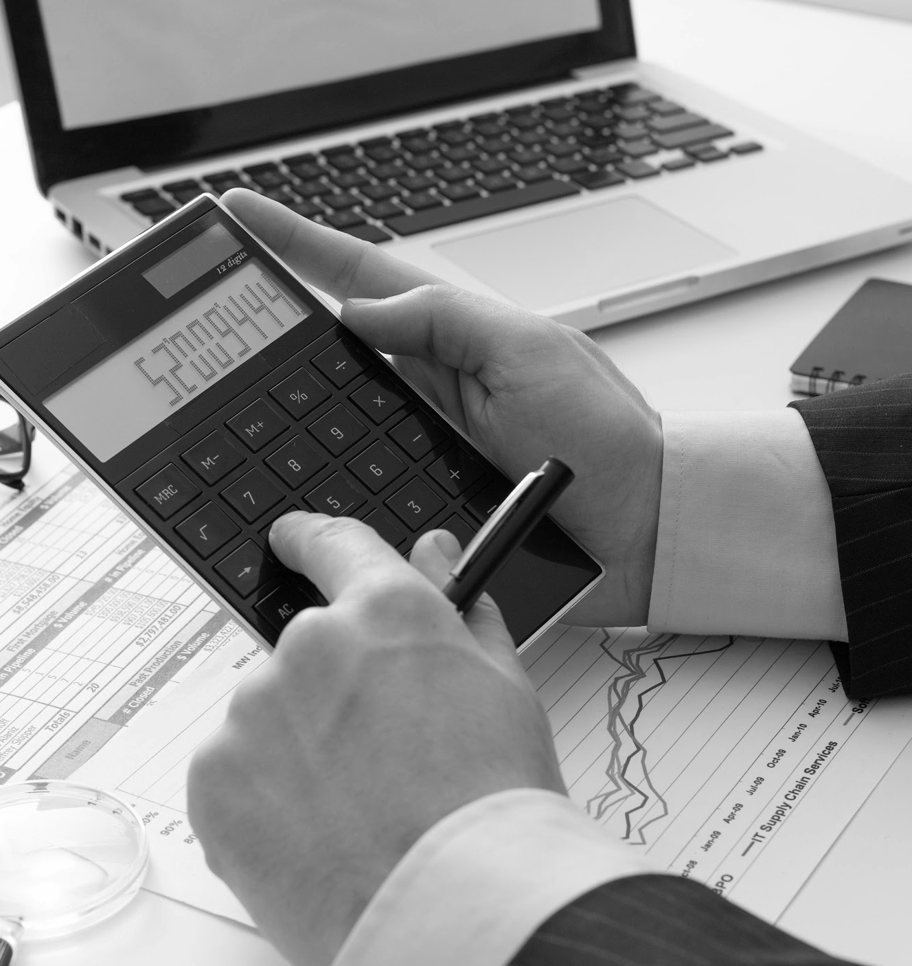
Here we will make a rough flowchart of working
Connecting all the python files and a data flow diagram

Slide 5
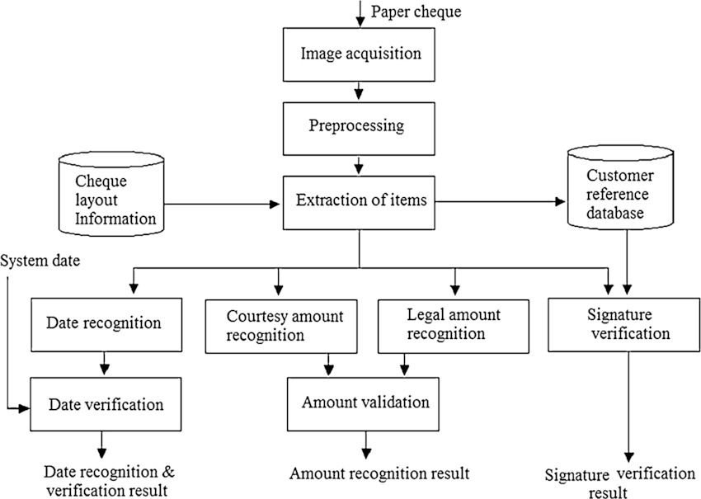
Data Flow

Slide 6
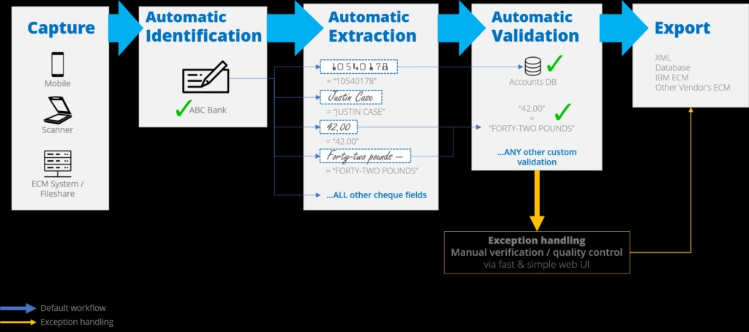
Process Flow

Slide 7
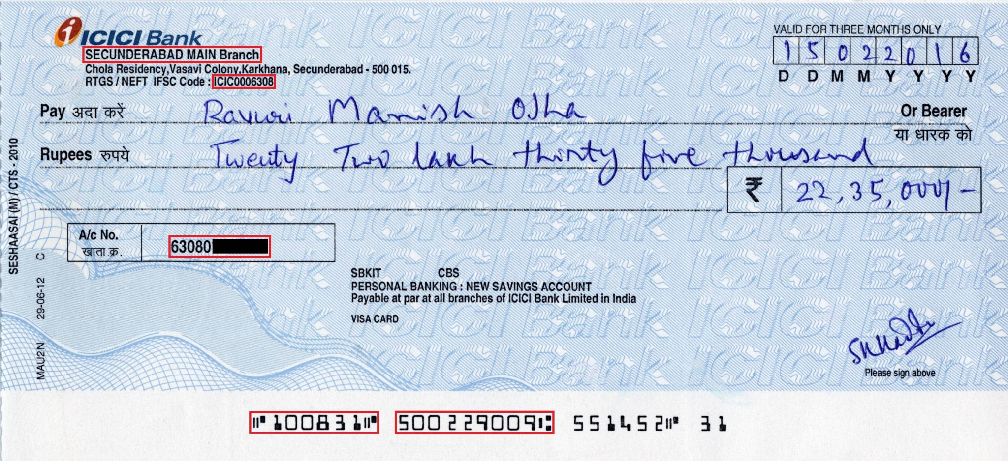
Reading Cheque Information (OCR)
The MICR code, account number and bank details(both in english and hindi) will be retrieved from the code using Tesseract Framework

Slide 8
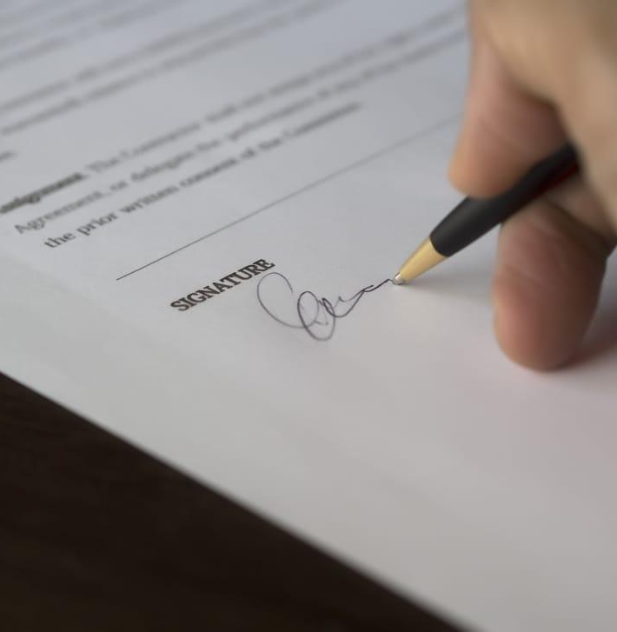
Verifying Signatures
Fill the details about which arch we using and the modules
Include the screen shot on the right

Slide 9
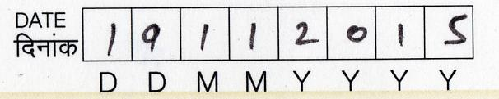
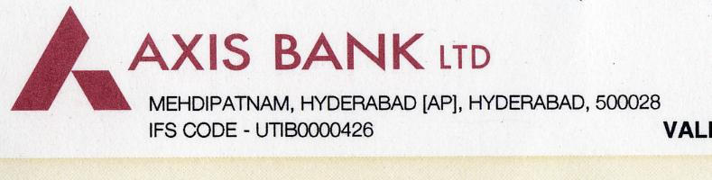
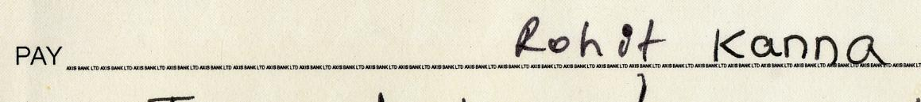
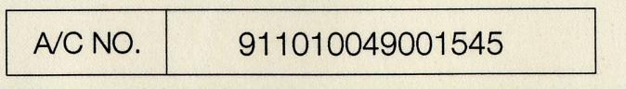
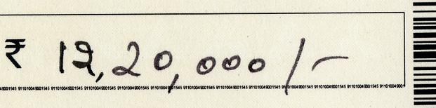
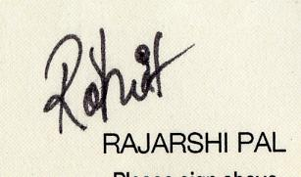
Checking Technical Details
To speed up the process we have compartmentalized the part of the cheque.
This ensures in reducing the noise while processing the cheque for the OCR and handwriting recognition.
We are following the CTS-2010 format

Slide 10

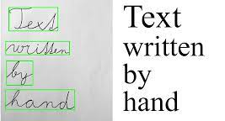
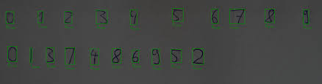
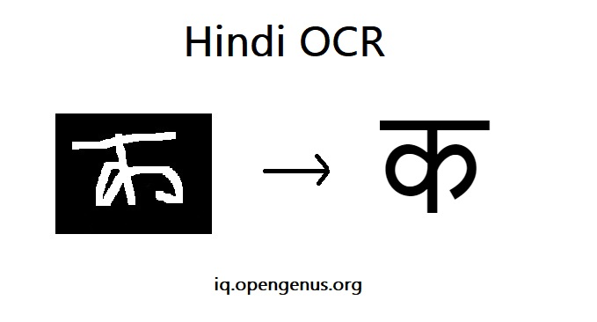
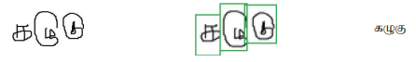
Handling Different Languages
The current OCR is using a threshold value to detect the language which is currently being used in the cheque using the langdetect module.
If any one of the languages (Here english and Hindi and Tamil) has a higher threshold, then we can apply the appropriate OCR.
This helps in effectively using the correct OCR for the correct data.

Slide 11
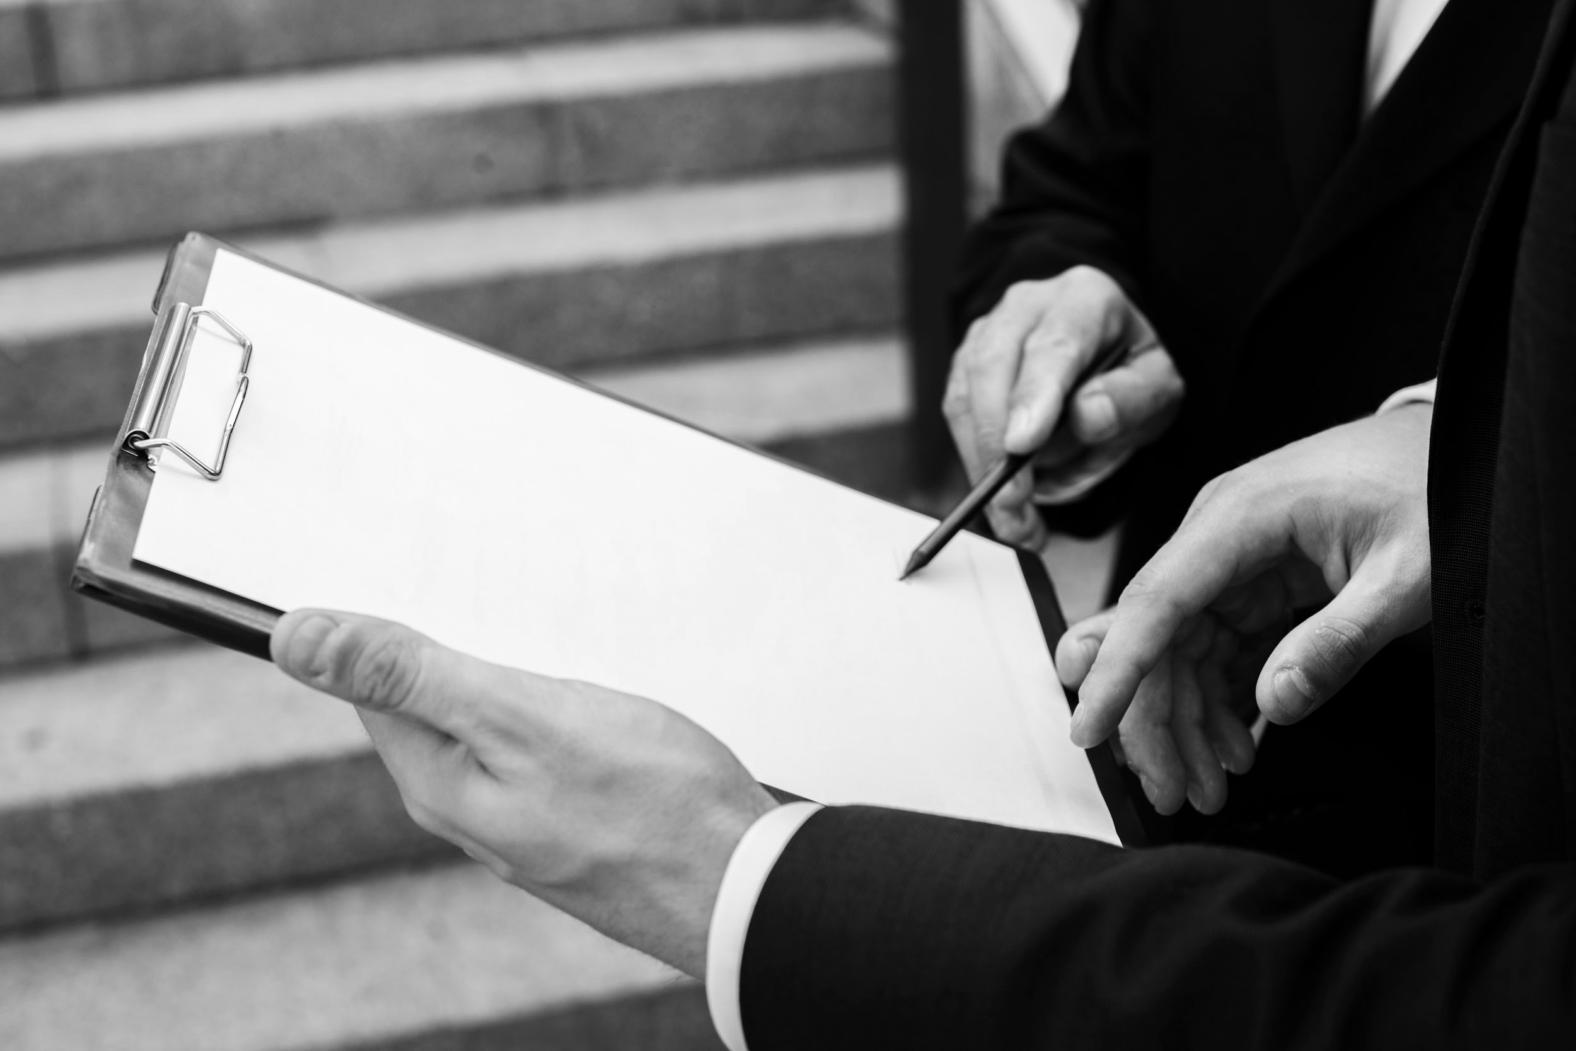
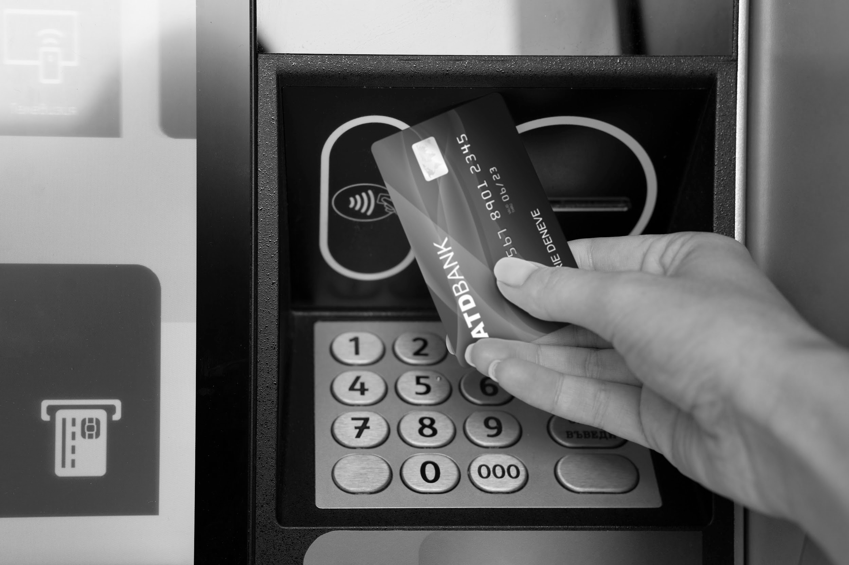
Detecting Fraud
chequeStop
The program stores a separate table containing the cheque number and the account number.
If an entry is found to match the processing cheque then it’s rejected
Cheque Issuing
The program incorporates an additional table designated for the storage of all received cheques.
The code checks if the particular cheque has been already issued or not. If yes, then it’s rejected.
Also we have to check whether the cheque is collected within 3 months.

Slide 12
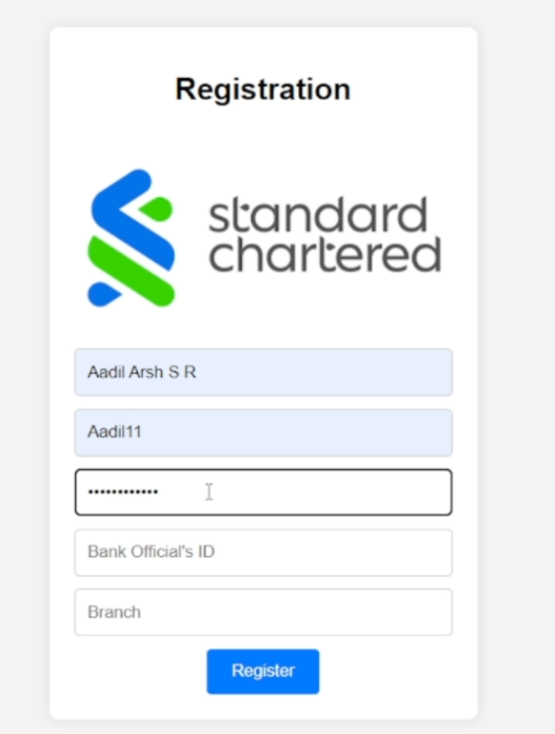
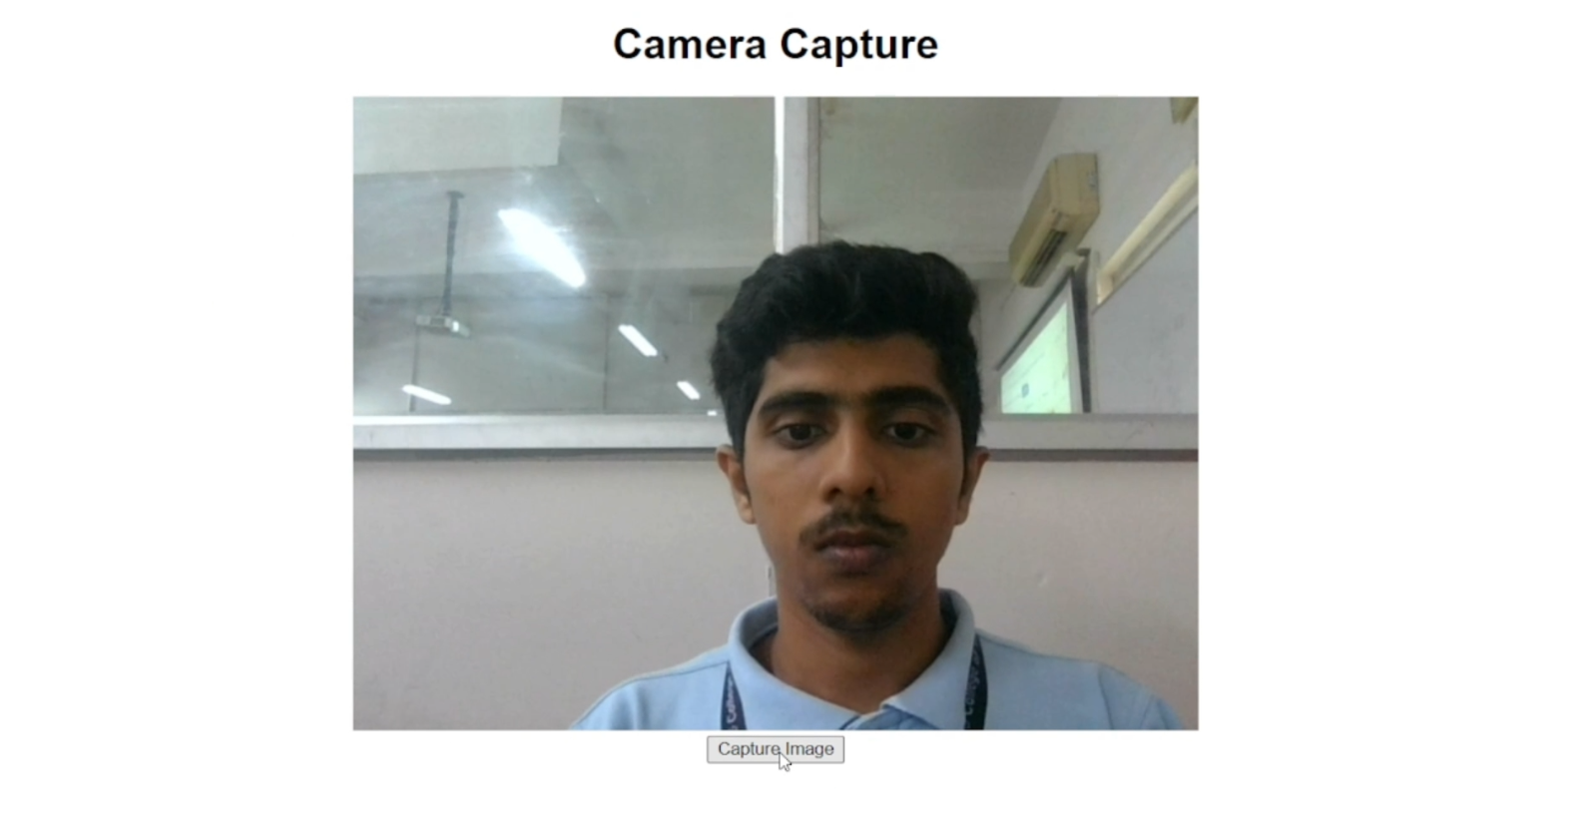
Biometric Authentication
This is to prevent unauthorized access to cheques processing system by people who aren’t bank officials.

Slide 13
Testing and improvement
Here include the confusion matrix and the wrongly predicted count.
Add the screenshot of the terminal on the left

Slide 14
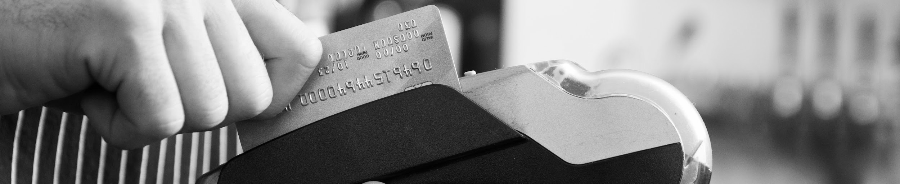
Thanks!

